Slide 1

BUS7C3 International Organisational Branding
Lecture 8 – Marketing Models and Theoretical Concepts of Organiational Branding

Slide 2

This week’s learning outcomes
At the end of this session, you will be able to:
Explain branding and marketing concepts and the importance of putting theory into practice.
Evaluate different brand equity models
Apply branding and marketing models/theories to organisations

Slide 3
Branding & Marketing theory
Brand theory relates to the strategic use of branding not as individual tactics, but as the foundation for company growth.
It's about aligning the core principles of messaging (advertising) and positioning (of the brand) to fuel marketing.
Marketing and branding theories are important as they provide a deeper understanding of customers and their needs, motivation, and goals.
They also facilitate an understanding the market in which the organisation is operating.

Slide 4
Brand concepts & putting theory into practice
Brand theory is the methodical alignment of all branding concepts. These need to fit within with a company's growth goals.
A brand concept is a structure that aids as a tool to guide the creation and management of brand assets. Brand assets are recognisable elements that embody a company's identity. From logos and typography to taglines, brand assets make it easy to identify a business and help it stand out from competitors.
A brand concept is usually a starting point and outline of reference for the creation of brand communications for example, a positioning message, how a printed brochure is designed, how a tweet is composed, or how a salesperson talks to a customer over the phone.

Slide 5
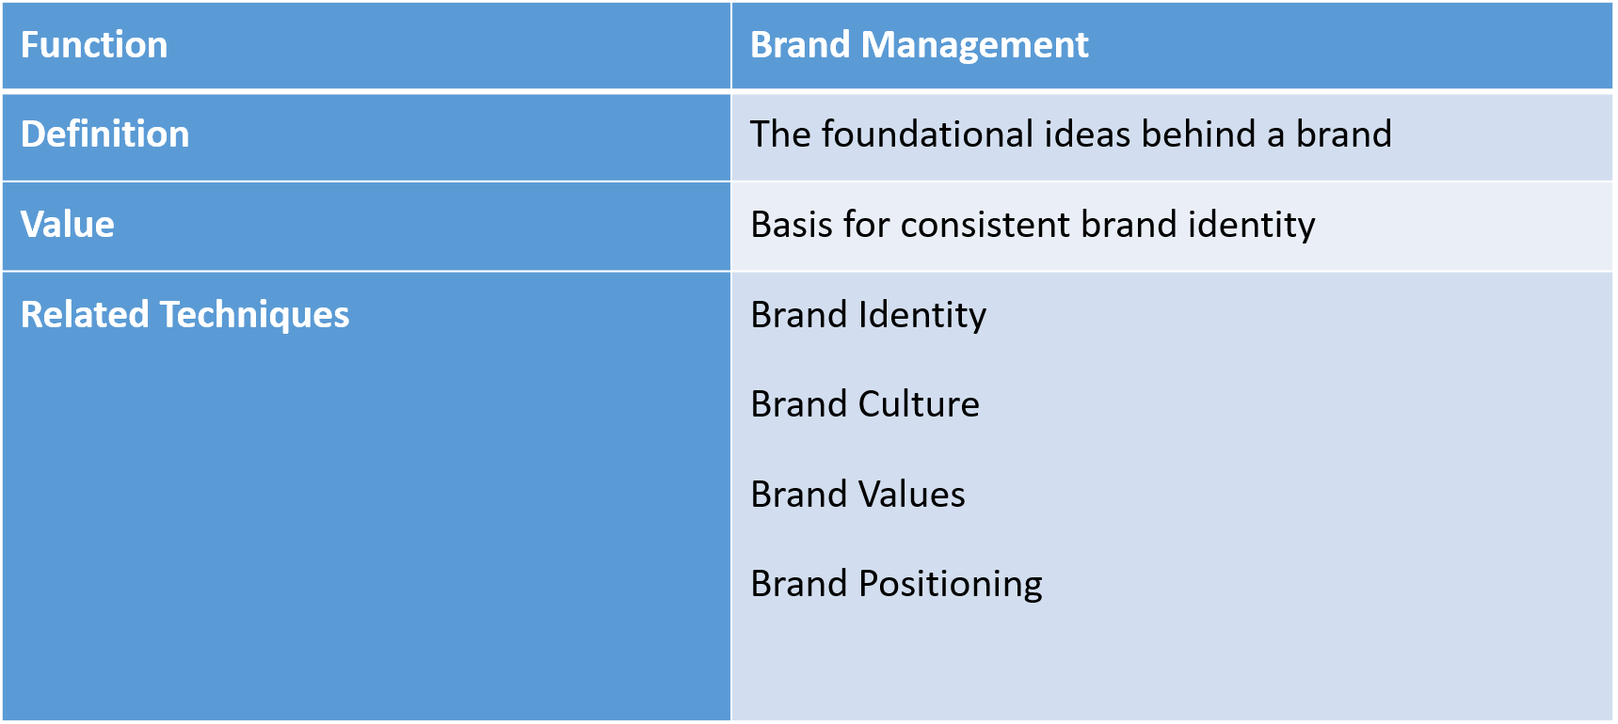
Brand concept overview (Spacey, 2017)

Slide 6
Key elements of Brand Concepts
Brand Name - name that is distinctive, unique, catchy, and enticing however, should not be vague.
Tagline - slogan of the brand, two to five words that convey the brand attributes and features in a short and efficient nature.
Creative Elements - the logo, mascot, typography, fonts, and colour palette, signifies the nature of the business, characteristics, and strengths of the brand as well as its offerings.
Language - range from sincerity, authoritative, helpful, or customer centric.
Message - information that the brand wishes to convey to its stakeholders, comprise of the mission statement, vision statement, and corporate guidelines.

Slide 7
Key elements of Brand Concepts
Brand Personality – This refers to human characteristics or traits associated with a company’s name. Designed to influence buyer perception of a brand and encourage loyalty through shared values or ideals.
Brand positioning is how a company positions itself in the market and in the minds of its target customers.
Brand recognition and brand awareness are closely related but have different objectives. While the goal of brand awareness is to clearly communicate a brand’s values and attributes to its target audience, brand recognition looks to maintain that awareness over time. Brand awareness is successful if buyers can easily understand what a brand represents.
Brand reputation refers to the perception of a brand’s image among the general public, in the media, or within an industry.

Slide 8
Types of brand concept – brand framework components
Brand Promise
Brand Atrributes
Positioning
Brand Personality

Slide 9
DRIP Framework
D
Differentete a product or service
R
Reinforce a brands message
I
Inform or make people aware of the brand
P
Persuade audiences to behave in a certain way

Slide 10
Brand equity model
Brand equity is the value of a brand based on the strength of its customer loyalty and recognition.
It is determined by the amount of positive sentiment a brand has among its customers, the perception of its quality, and its ability to command a premium price.

Slide 11
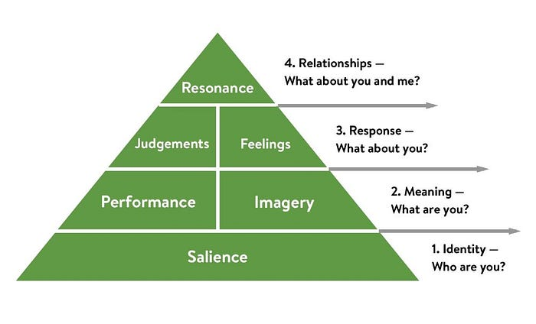
Keller’s Brand equity model (1993)

Slide 12
Brand equity model explained
Level 1: Brand identity (who are you?)
This is how customers look at your brand and distinguish it from others. It’s the most important stage and must be strong to support the rest of the pyramid above it.
Brand identity builds when customers start off unaware of your products and values, then you can attract them with ad campaigns and targeted marketing that increase awareness.

Slide 13
Level 2: Brand meaning (what are you?)
When customers become aware of your brand, they’ll want to know more about it. Do its features work well? Is it reliable? Does it look good? Is the customer service good? Is it value for money? This is brand meaning and is divided into two components:
Brand performance: when a brand ‘does what it says’ and performs well over time, it will be loved and trusted (e.g. Apple, Microsoft, Virgin)
Brand imagery: what does the brand appear to be to customers? Land Rover must appear rugged, but Kleenex must appear soft, and this messaging must come out in targeted marketing

Slide 14
Level 3: Brand response (what are the feelings for the brand?)
Once a customer has bought the brand, they assess whether it aligns with their expectations.
If they like the product, they have feelings for it. They proliferate the brand to friends, family, media channels etc. They will start to become an advocate for the brand.
If they are disappointed with their purchase, their judgment of it will be negative. They may not buy another product from that brand and may criticise it widely.
They become a brand detractor. Companies need to address judgments and build positive feelings at Level 3 to reach level 4

Slide 15

Level 4: Brand resonance (that strong relationship)
This occurs when a customer likes a brand so much that they would not consider buying another one
They feel a relationship with it and a connection with other buyers (brand advocates)
Example - Harley-Davidson – brand affinity.
The way up to the resonance level affords brand opportunities to recognise and capitalise on its customers’ loyalties and attitudes – both positive and negative.
By using Keller’s model marketers can understand what their customers want and need before they’ve even bought the product, or maybe even before they know they want it.

Slide 16

Another example - iPad
From the robust foundation of Apple’s brand identity, the iPad was developed to look great, be easy to use, do everything its customers wanted, and more.
Customers loved the product and any glitches that attracted negative responses were quickly patched.
Over time, there were a significant number of brand advocates.
It can now be found in stores, health centres, schools, offices and homes.
We didn’t know we wated it but now we can’t live without it

Slide 17
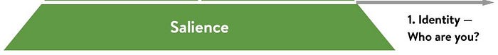
How to apply Keller’s Brand equity model
The biggest question to answer here is “Who are you?”
Brand salience, or awareness, refers to how you are perceived by your customers. What do they think about your brand, and is that thinking even accurate?

Slide 18
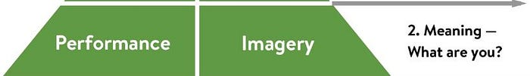
How to apply Keller’s Brand equity model
Performance indicates how well your product satisfies the needs of your customers. Does the product do as you advertise?
To provide clarity, Keller’s model breaks down performance into 5 specific key performance indicator categories.
primary characteristics and features
product reliability, durability, and serviceability
service effectiveness, efficiency, and empathy
style and design
Price
Imagery refers to your brand’s social currency. How does your brand appear to customers/potential customers and how will they talk about you?

Slide 19
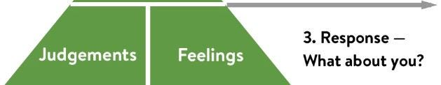
How to apply Keller’s Brand equity model
What do people associate with your brand? How is perceived by the customer and how does it make them feel?

Slide 20
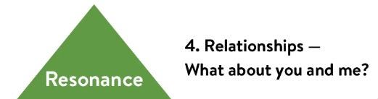
How to apply Keller’s Brand equity model
The most difficult level to reach
Brand resonance is how a customer identifies themselves with the brand. This is the strong, lasting relationship your brand hopes to build with each customer you gain along your business journey.
The idea is that your brand resonates with customers so much that not only do they keep coming back, but they become your brand’s advocates.

Slide 21
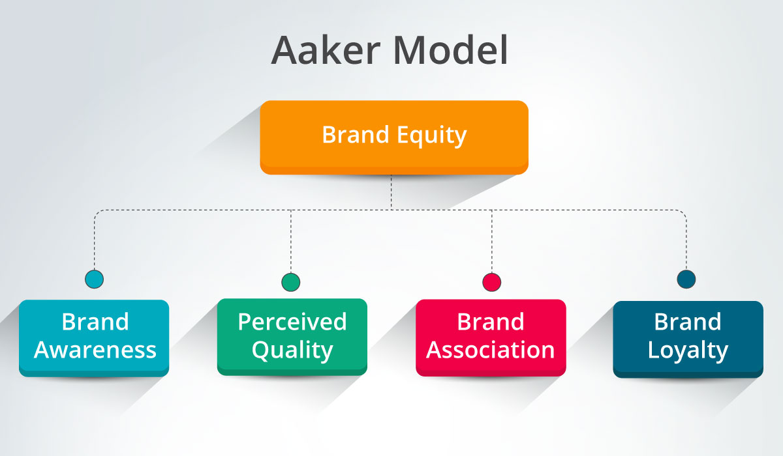
Aaker’s brand equity model (2009)

Slide 22
Aaker’s brand equity model
Brand awareness: how known is the brand to the public? This is the starting point of building brand equity.
Brand loyalty: how loyal are people to the brand? Loyalty is hard for competitors to copy, so it gives a brand time to respond to competition.
Perceived quality: is the brand known or expected to deliver good quality products? Quality above features will give a product the edge with consumers – for a while, until they begin to demand the features.
Brand associations: what do people feel when they see the brand?

Slide 23
Aaker – continued
Keller’s brand equity model focuses largely on emotions; however the key component of Aaker’s model is recognition. The most successful brands are those that drive recognition (Mickey Mouse & Disney) in the emotional part of the brain that makes split-second decisions about what to buy.
Aaker sees brand equity as a mixture of brand awareness, brand associations and brand loyalty. All these add up to the value provided by a brand’s goods or services.
Aaker’s model can help to create a clear brand strategy made up of various components that separate a brand from its competition and advance it.
Aaker outlines 5 key elements of 5 elements of brand equity: The ones we have discussed – awareness, loyalty, quality & associations. There is also the additional component of patents, IP and trading partners.

Slide 24
How Aaker’s model helps to define brand identity (a quadrant)
Brand as product. This quadrant comprises the outreach of the product, it’s different features, its level of quality and potential value. Also included is the ways it is used, what type of people want it and where it originated geographically.
Brand as organisation. This section contains the different elements attached to the brand organisation, in particular, things such as how well people trust it, does it seem forward-moving and any potential negative considerations. It also includes local versus global activities.

Slide 25
How Aaker’s model helps to define brand identity (a quadrant)
3. Brand as person. This quadrant is made up of the many different customer and brand relationships, as well as the personality of the brand. This typically includes descriptive traits such as optimistic, caring, customer-oriented, etc.
4. Brand as symbol. Included in this section are the different types of branding symbols attached to a brand, such as visual elements, brand history and audio elements.

Slide 26
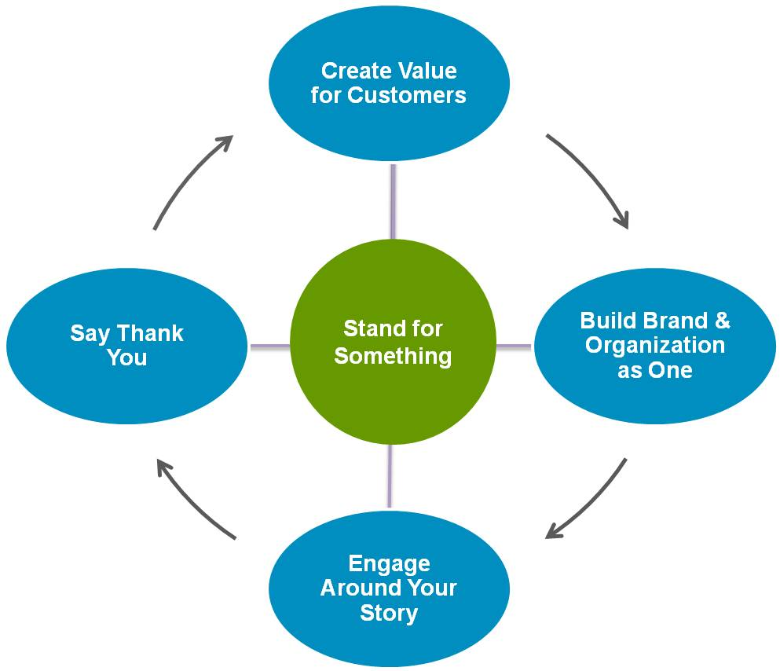
Simon Uwin’s Loyal Brand Framework (2014)
STAND FOR SOMETHING - Develop a core purpose, rooted in improving people's lives, that will inspire employees, customers, and communities alike.
CREATE VALUE FOR CUSTOMERS - Earn the right to exist, by creating something that's useful, affordable, and has meaning.
BUILD BRAND & ORGANISATION AS ONE - Embed a brand culture that lives and breathes the brand.
ENGAGE AROUND YOUR STORY - Develop a compelling story, and engage employees, customers, and communities in telling it.
SAY "THANK YOU" - Make customers feel appreciated and build relationships with them over time.

Slide 27
AIDA model
A - Attention
I - Intrest
D - Desire
A - Action
Attention / Awareness: I know. (Draw attention, raise awareness)
Interest: I like (Give information, arouse interest)
Desire: I want (Create the desire to be preferred)
Action: I am taking it (Convince for action)

Slide 28
Steps in the AIDA model
Attention – In order to make customers aware of offerings, a marketer needs to catch their attention and notice or take in visual media – easier for multinational companies
Interest – Customer interest must be piqued and held long enough to gain information about the product.
Desire (or Decision) – Desire is often built up by selling on a product's features, showing superiority over similar products and demonstrating versatility.
Action – If the customer has come this far, there is interest. The final step is closing the sale and convincing the customer to act on interest.

Slide 29
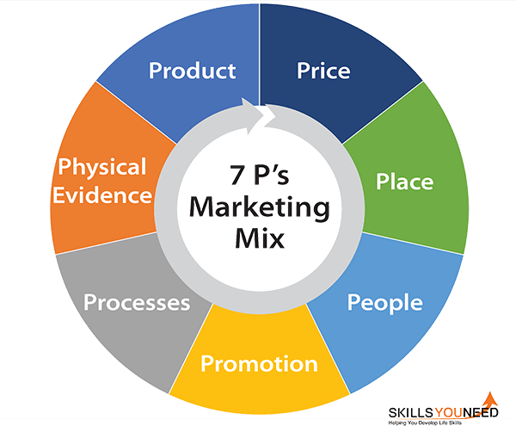
The marketing mix – 7ps
McCarthy (1960) the 4Ps, product, price, place, promotion
Increased to 7ps to add people, physical evidence, processes
At its core, a marketing mix is focused on promoting a product or service to generate revenue for a company. However, it integrates key marketing strategies that create brand awareness, build customer loyalty, and drive product sales .

Slide 30
Product
The first element of the marketing mix is your product.
A product can be an item or service that is built to satisfy the needs of a consumer group.
The critical component of an effective product is ensuring that that you have the right product for the demands of your market.
An organisation would need to assess the way that the brand offerings are evaluated.
Assess whether the brand is offering the right solutions at the right time
Consider….
What does the customer stand to gain from the service/product?
How will the customer use the product?
What features must the product have to meet consumer needs?
Have any necessary features been missed?
Are there any unnecessary features?
How is the product different from those offered by competitors?

Slide 31
Price
It’s important to regularly assess the cost services and products to make sure that the organisation aligns with the marketplace.
Pricing is important as it will always have an impact on your customer’s perception of you (think about the brand’s image)
In some industries, a low price will be crucial. In others, a price that’s too low will indicate an inferior product or service.
Flexibility in pricing is also important
Consider….
How much it costs to make the product?
What the perceived product value is for the customer?
Whether a slight decrease in price could improve your positioning?
Whether the current pricing can keep up with competitors?

Slide 32
Place
Placement is often an overlooked aspect of branding and marketing.
However, placement is essential in the marketing mix.
The organisation needs to be equipped to position and distribute the product in a format that’s accessible to potential buyers.
An in depth understanding of the target market is required for this
Consider…
Where the customers look for the product.
Where the customers spend their time Highstreet, in store, online, etc.
How the distribution strategy is similar and different to the competitors.
Whether there is a requirement for a stronger sales force.

Slide 33
Promotion
Promotion includes all communication methods that an organisation uses to tell customers about their services or products.
Even minimal changes to your promotion and sales strategies can introduce dramatic changes to your engagement and profits.
Changing the subject line on emails or switching out a colour on branding materials can all lead to instantly higher sales.
Think about the importance of evolving – changing brands
Consider….
How can the organisation engage with potential buyers?
Where can an organisation find potential customers?
What is the best time to promote a product or service?
Can the organisation benefit from a range of cross-communication solutions?
What promotional strategies do competitors use?

Slide 34
People
Excellent customer service not only converts to sales but can increase the customer base by referrals.
It’s important that everyone who represents the brand or deals with customers – including the digital I.e. chat bots– are fully trained sales professionals with a detailed knowledge of the product.
Employees deliver the service and or product, so it is important to look beyond the customer as well.

Slide 35
Physical evidence
Physical evidence incorporates aspects of the organisation that proves the brand exists and that a purchase took place.
Examples of proof that a brand exists can include physical stores , offices, websites, receipts, invoices, follow up emails, newsletters etc.
The organisation's marketing mix must also take into consideration all the things your customer sees and hears in relation to your product or service i.e. packaging, branding, store placement, social media etc.

Slide 36
Process
This aspect focuses on the process of delivering the product to the consumer.
The idea is that your processes should be designed for maximum efficiency and reliability.
However, they should also include features that are in line with the brand i.e. if you have a sustainability focus for example.
Think about online shopping, digital partnerships, logistics, supply chains etc.

Slide 37
Other models and concepts to consider in your reading & how to view them
Customer journey mapping
Customer lifetime value
Porter’s 5 forces
PESTLE
STEEPLE
SWOT
RACE
There are others…but the important factor in using theories and models is to:
Be critical!
What are the pros and cons of the models/theories?
Are some out of date?
What is the most appropriate one to use for the organisation you are evaluating?
Read around these theories and models, don’t take them at face value!

Slide 38
Over to you – group activity
Select an organisation as your focus for this exercise – remember the international element.
Use one of the theories/models covered today and assess your organisation against the model.
Provide a short presentation to the class.
You should include:
A brief overview of your company
A brief explanation of the model chosen and address why this is the most appropriate model.
A discussion of the findings of your evaluation

Slide 39

Thank you!
Any questions?

